Slide 1
ADAS UX Library
LabVIEW UI components for Measurement Plugins

Slide 2
Components
Attila
Jesse
Status (String)
User Input for strings
Path control (files)
Buttons for actions
Interfaces Name (devices)
Boolean indicators for connection status
Image display
Tables
Filtering Control (tokenize the user input and parsing)
Peter
VI Icon Definition

Slide 3
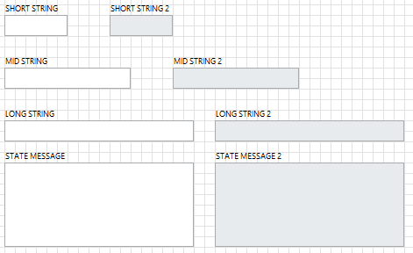
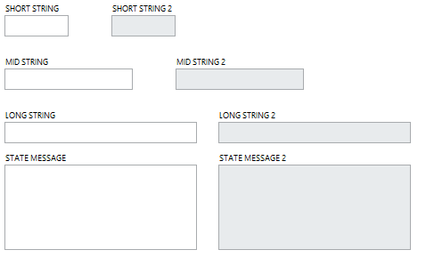
String
LabVIEW
Instrument Studio

Slide 4
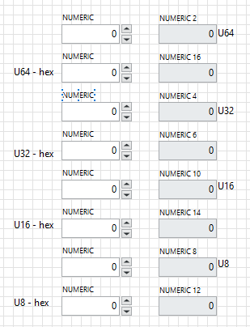
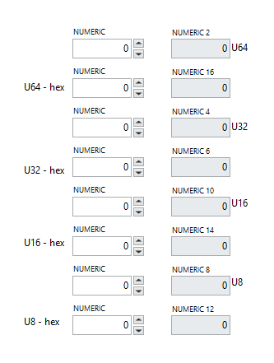
Numeric
LabVIEW
Instrument Studio

Slide 5
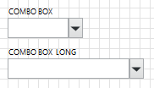
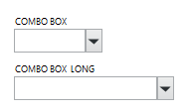
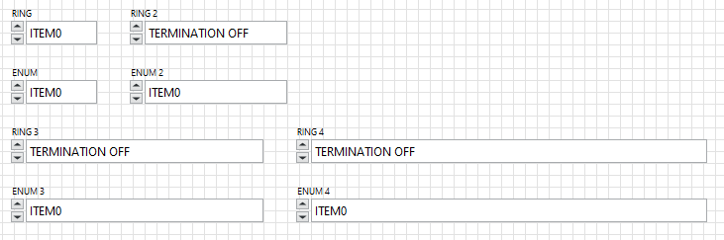
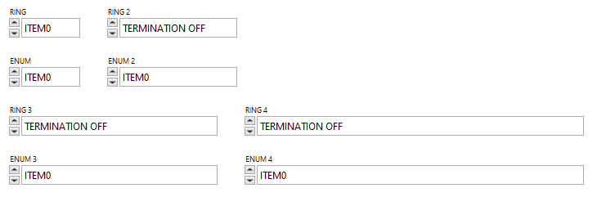
Combo Box, Ring
LabVIEW
Instrument Studio

Slide 6
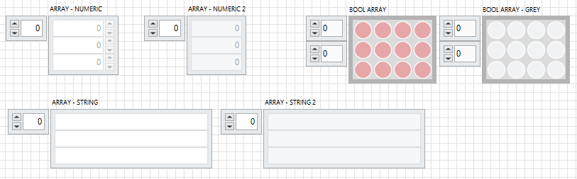

Array
LabVIEW
Instrument Studio

Slide 7
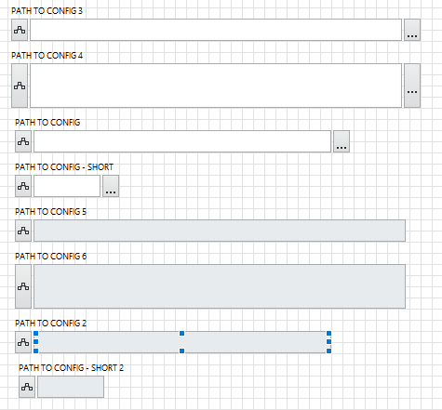
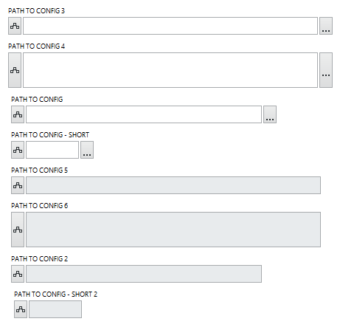
Path
LabVIEW
Instrument Studio

Slide 8
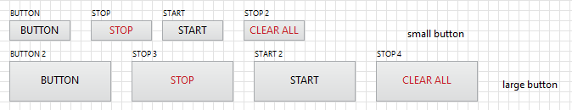
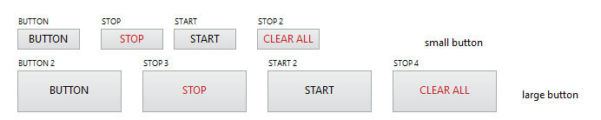
Button
LabVIEW
Instrument Studio

Slide 9
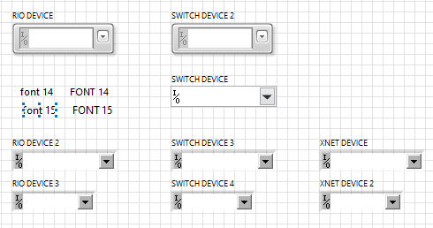
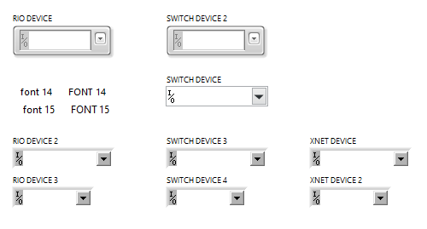
Interfaces Name (Devices)
LabVIEW
Instrument Studio

Slide 10
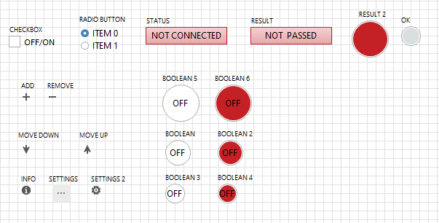
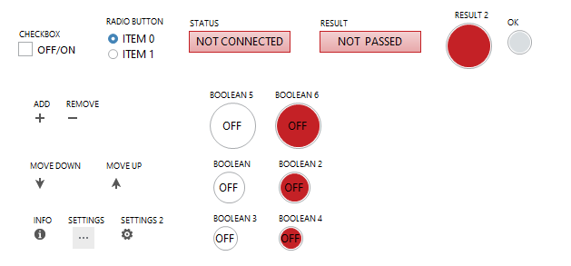
Checkbox, Radio button, Status / Result, Boolean, Icons
LabVIEW
Instrument Studio

Slide 11
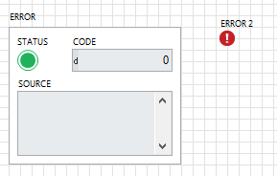
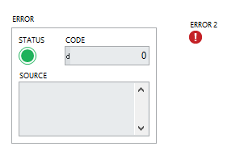
Error
LabVIEW
Instrument Studio

Slide 12
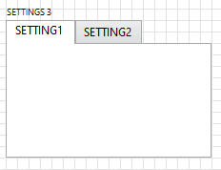
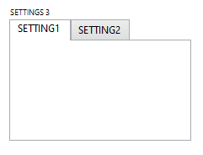
Tab Control
LabVIEW
Instrument Studio

Slide 13
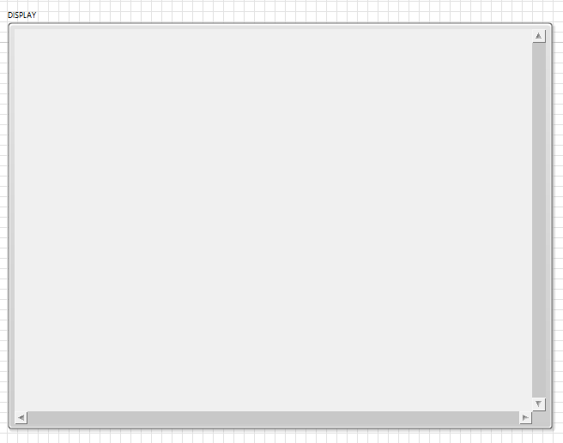
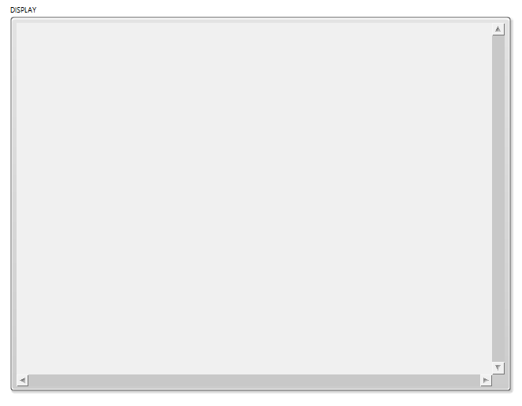
Image display
LabVIEW
Instrument Studio

Slide 14
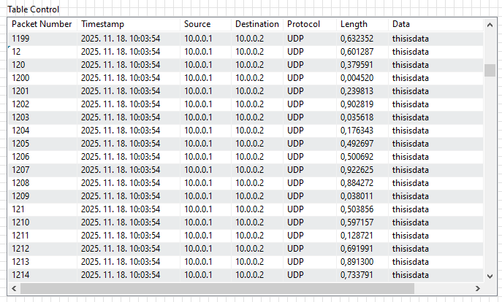
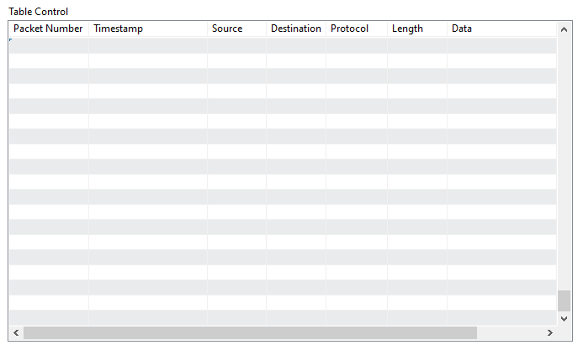
Table
LabVIEW
Instrument Studio

Slide 15


Filter String
LabVIEW
Instrument Studio

Slide 16












VI Icon Definition for Measurement Plugins
CAN/LIN ​Raw Bus Capture ​
Automotive Ethernet Raw Bus Capture ​
Automotive Vision Acquisition
I2C Capture Plugin​
NI-Switch​
CAN/LIN ​Frame Generator

